Slide 1
Crystal snow ball
Presented by Boyu LIU, Tianci WANG and Rui YAN
For cs148 @Stanford summer 2016

Slide 2
Problem statement
Background image
Glass ball
snowflake
base
desk

Slide 3
Source
OpenGL, glew, glfw, glm
No glut!
Shader.h, Camera.h from Homework 3
Bitmap.h from ???
…

Slide 4
How is it related to cs148
Topics related:
OpenGL (Of course!)
Shaders & Materials

Slide 5
Different movement mode
We have three movement mode:
Press 1 – move randomly
Press 2 – fall down with gravity without rolling on the ground
Press 3 – fall down with gravity with wind from the bottom of the sphere

Slide 7
Algorithm/Steps
Setup sky box
Use small triangles to build a huge sphere
Add refraction and reflection to the sphere
Draw snowflake and simulation different mode of movement
Load inner object

Slide 8
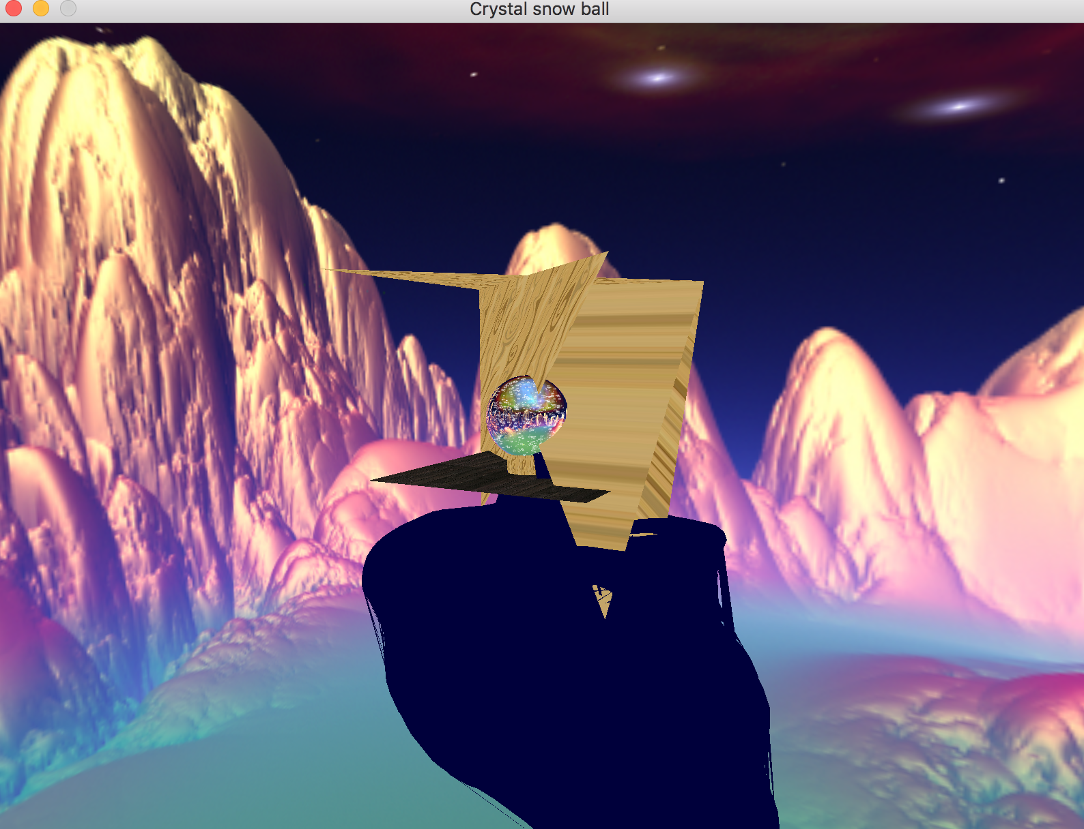
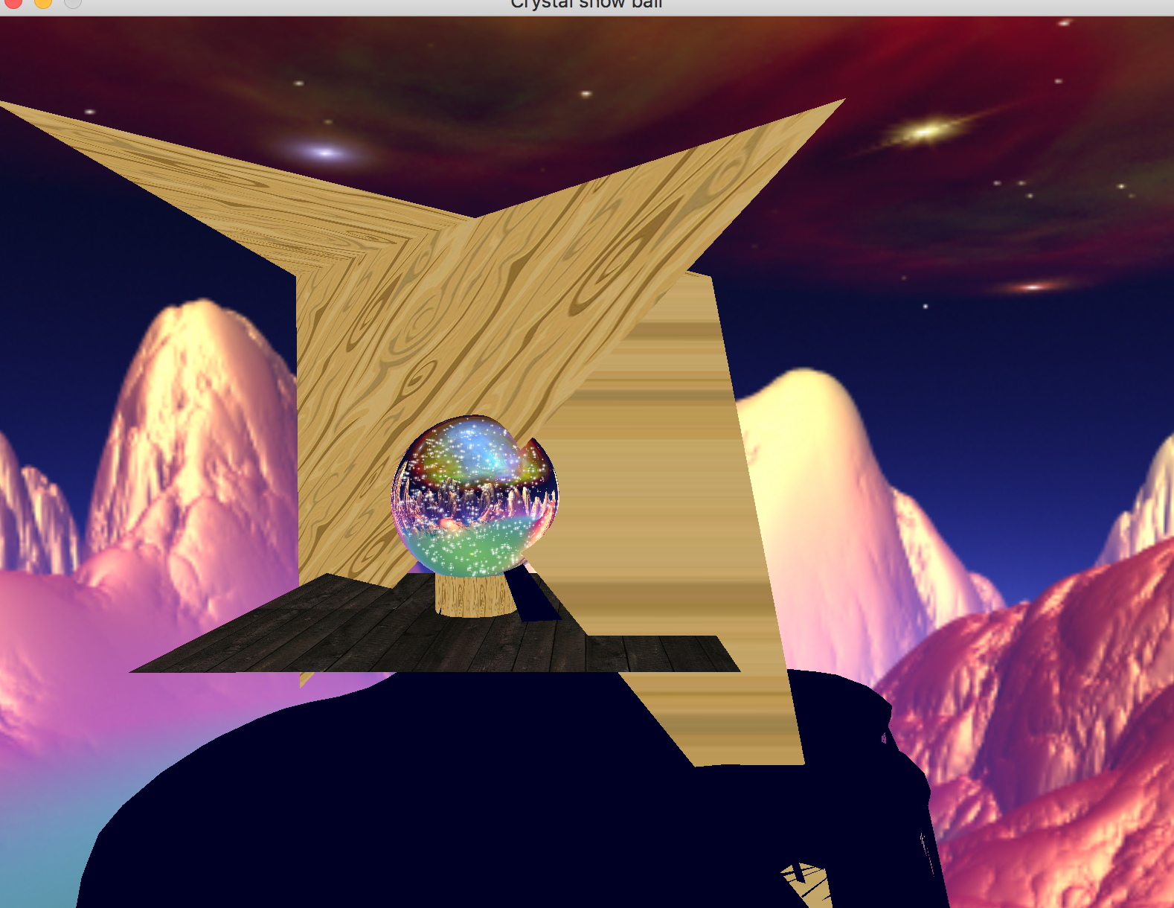
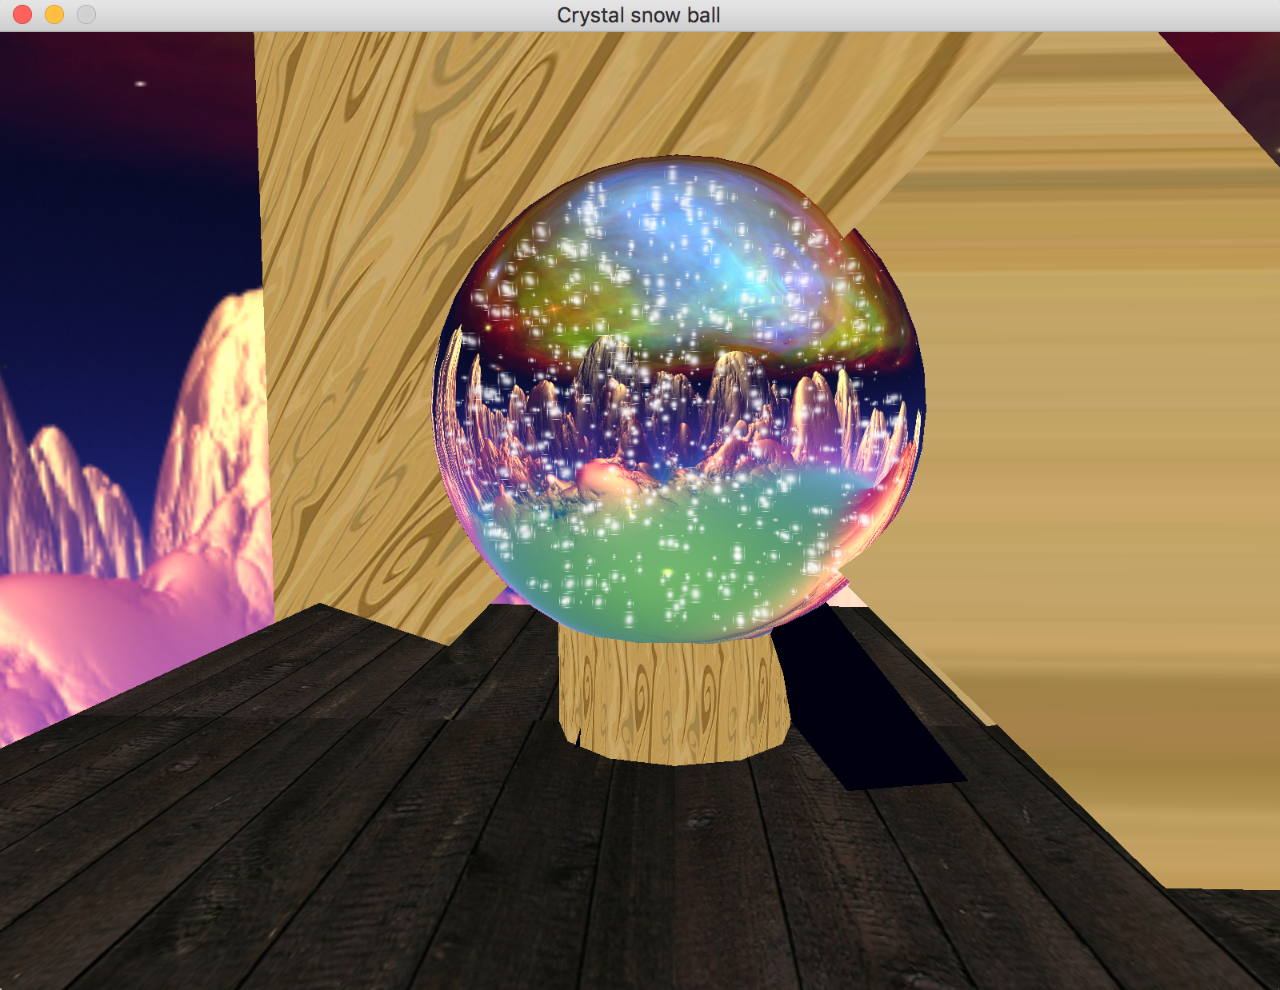
Problem?
Need Glass-like material
Original way of simple environment mapping provides ‘static’ refraction, and no reflection.

Slide 9
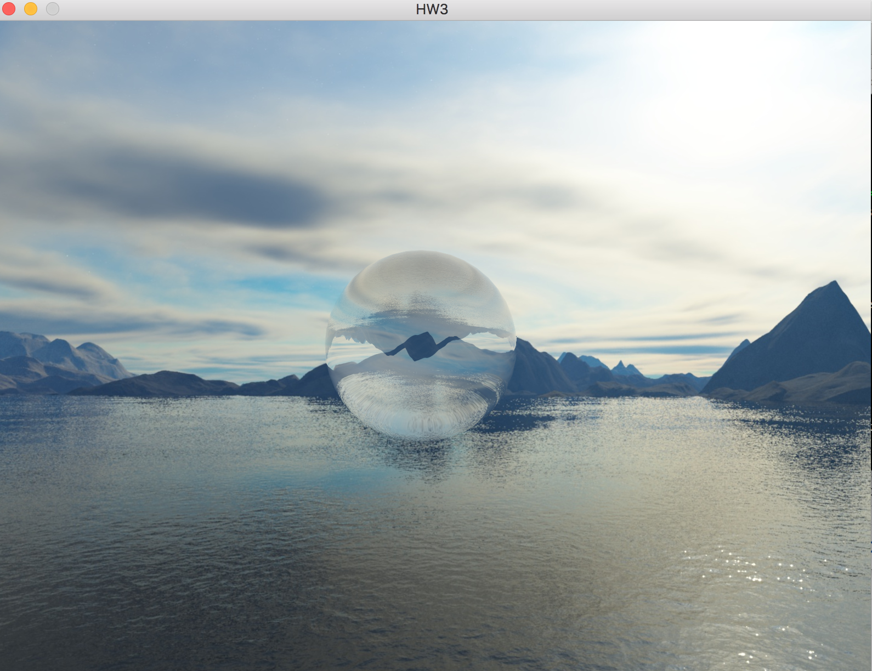
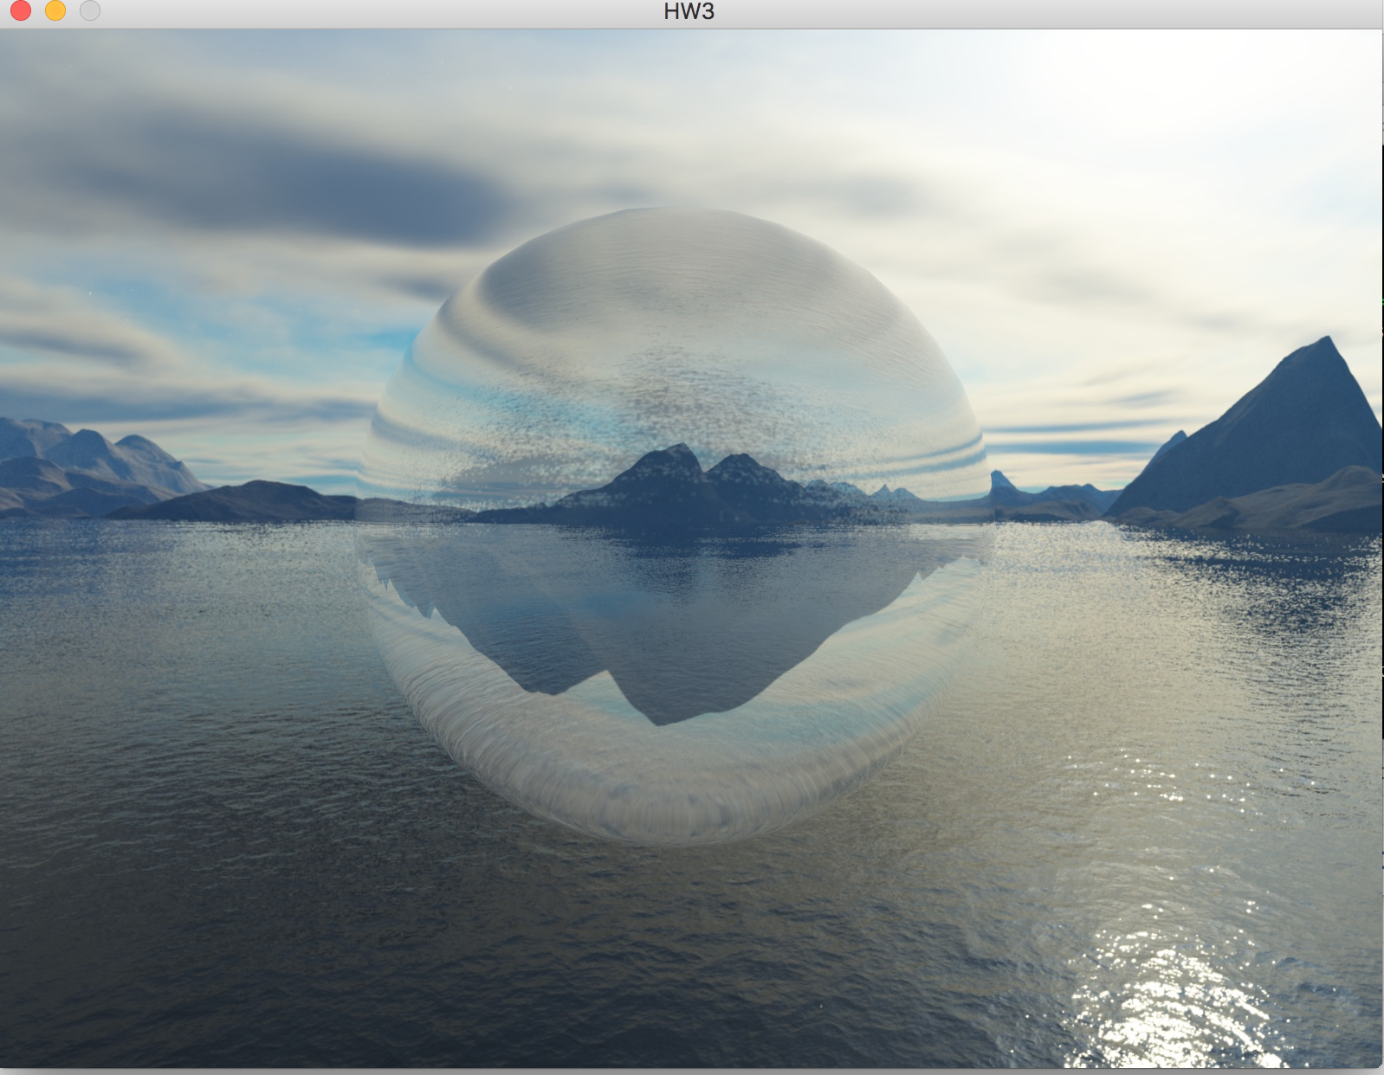
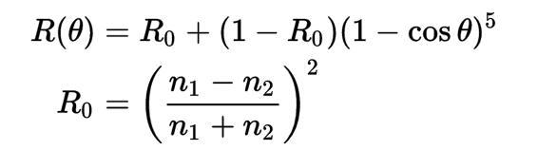
Solution!
Fresnel reflection
Schlick's approximation

Slide 10
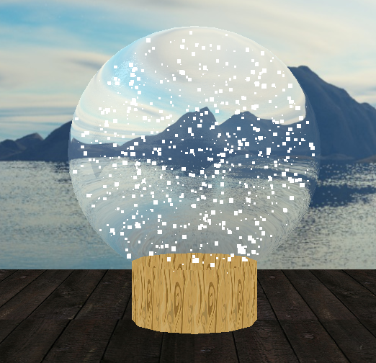
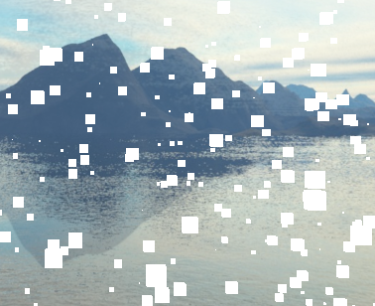
Problem?
Simulate snowflakes
Use small cubes

Slide 11
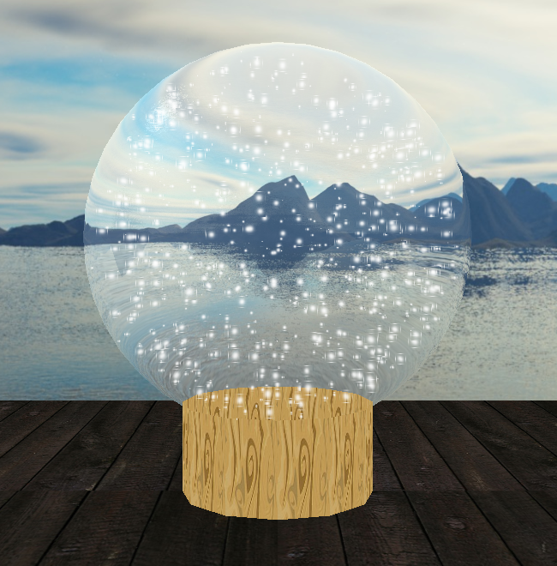
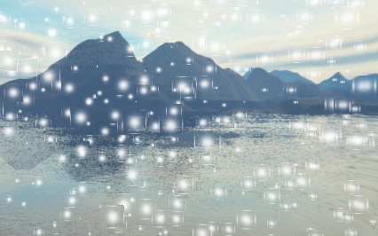
Solution!
Simulate snowflakes
Use small cubes
Use alpha blend to emphasize the area in the middle

Slide 12
Problem?
Order of layout..
The floor need to share the same depth buffer with either snowflakes and crystal ball.
The depth buffer need to be cleared after draw of crystal ball & before draw of snowflakes.
sd
d

Slide 13
Problem?
Order of layout..
The floor need to share the same depth buffer with either snowflakes and crystal ball.
The depth buffer need to be cleared after draw of crystal ball & before draw of snowflakes.
Object load with wrong normal

Slide 14
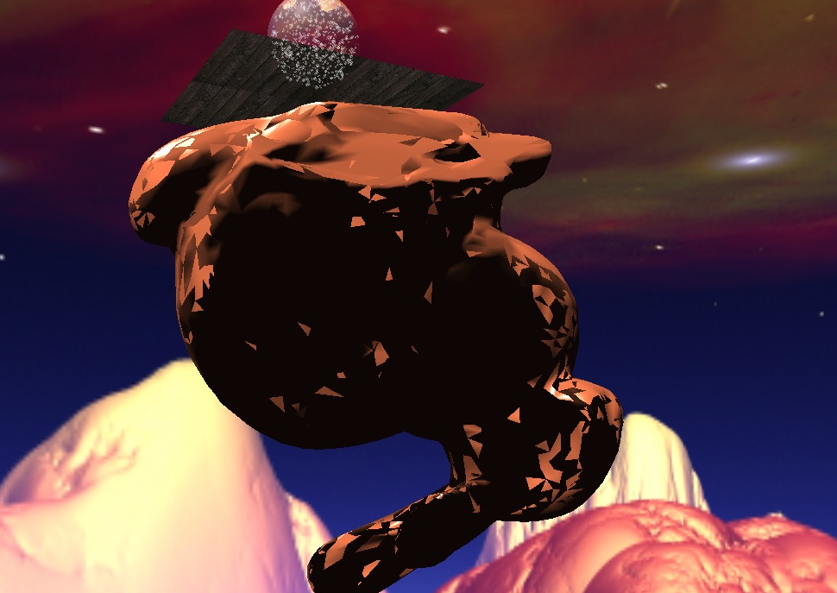
Problem?
Nightmare for
a bunny
Look from the bottom If drawing ground
after drawing the snowflake

Slide 15
Solution!
Ddd
Sss
ss

Slide 16
Solution!

Slide 17
Final results

Slide 20
Q&A
Presented by Boyu LIU, Tianci WANG and Rui YAN
For cs148 @Stanford summer 2016

